Slide 1

Android App Development Session 9

Slide 2
Contents
Content Providers

Slide 3
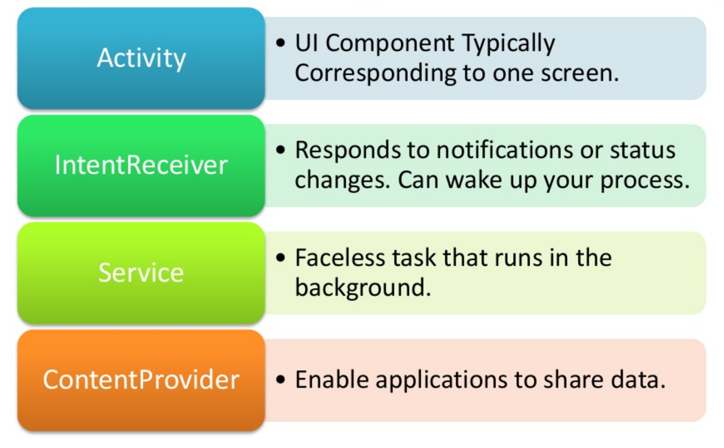
Android Building Blocks

Slide 4
Content Providers
Content providers store and retrieve data and make it accessible to all applications.
They're the only way to share data across applications; there's no common storage area that all Android packages can access.
Android ships with a number of content providers for common data types (audio, video, images, personal contact information, and so on).
You can see some of them listed in the android.provider package.
https://developer.android.com/reference/android/provider/package-summary

Slide 5
Built-in Content Providers
Browser
Browser bookmarks, browser history
CallLog
Missed calls, call details
Contacts
Contact details
MediaStore
Media files
Settings
Device settings and preferences

Slide 6
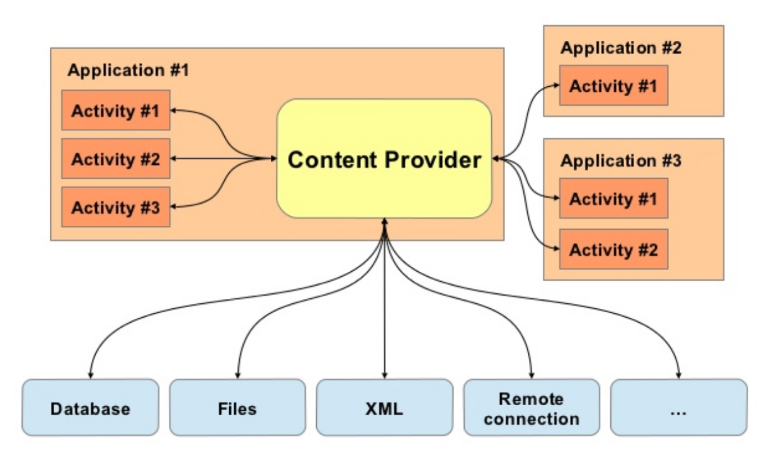
Structure

Slide 7
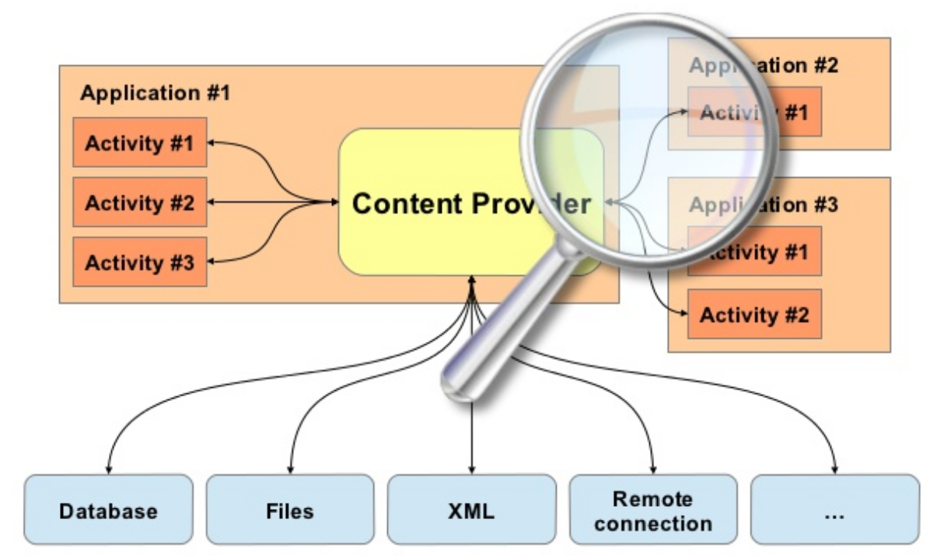
Structure

Slide 8
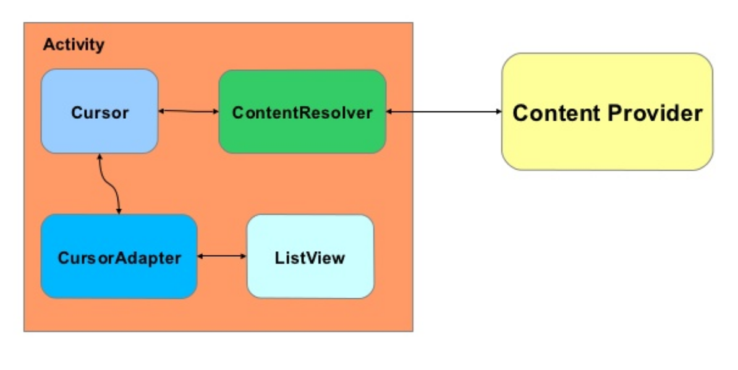
Structure

Slide 9
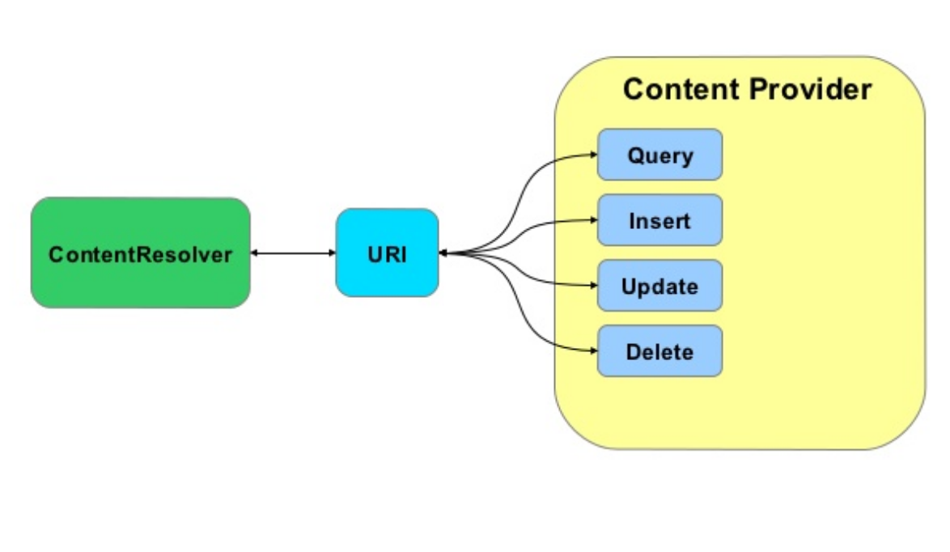
Structure

Slide 10
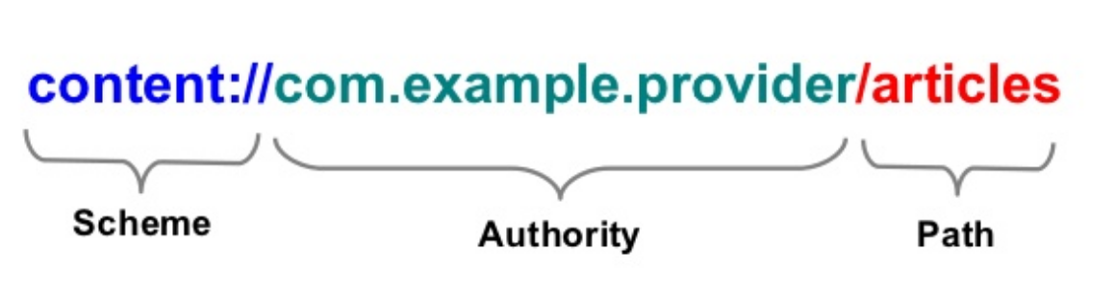
URIs

Slide 11
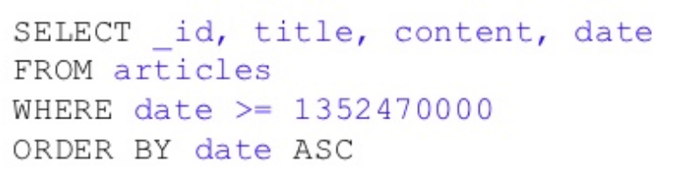
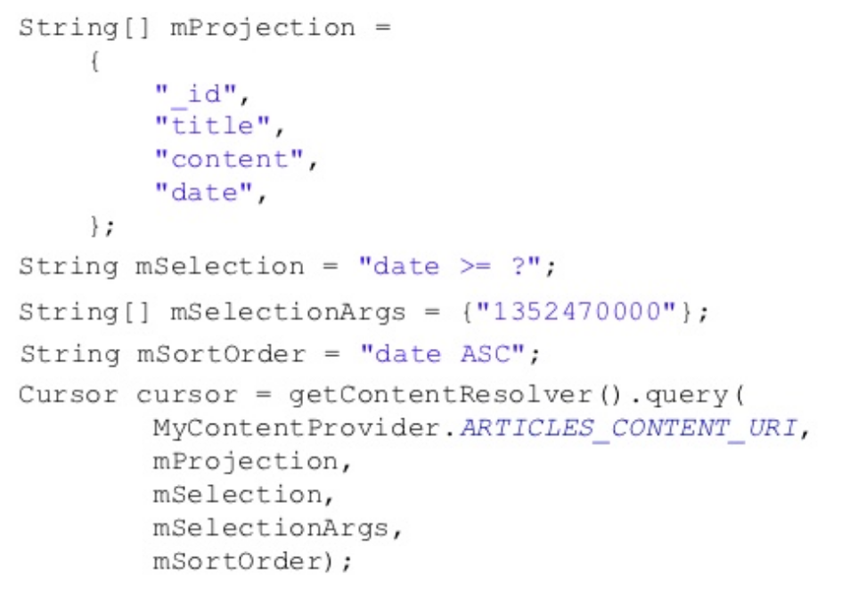
Constructing Query

Slide 12
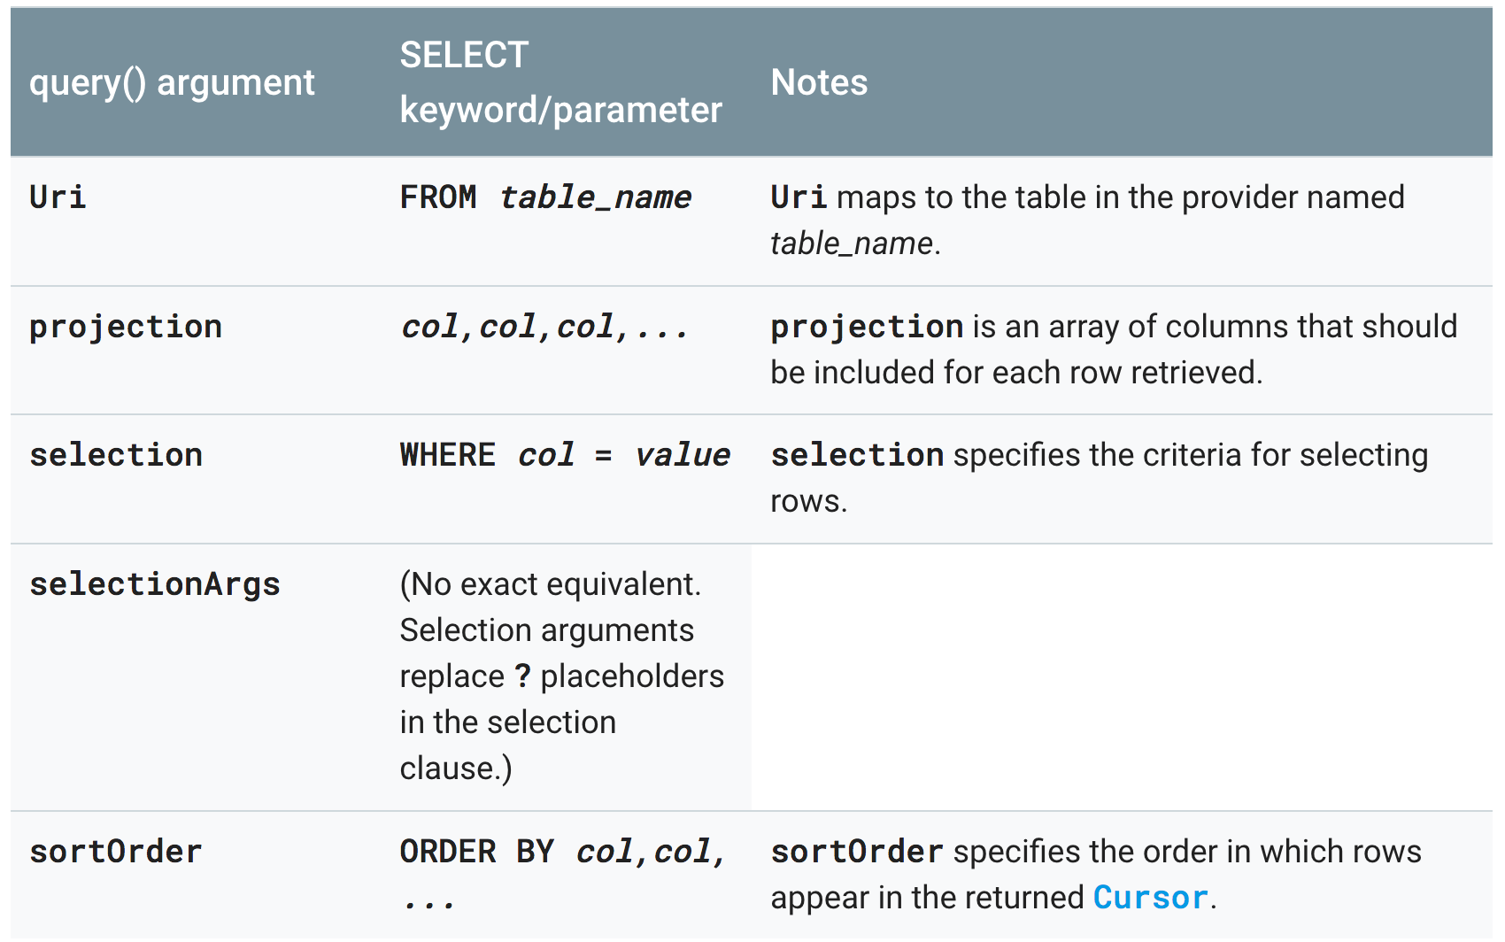
Constructing Query

Slide 13
References
https://developer.android.com/guide/components/services

Slide 14
Thanks!
Any questions?
You can find me at bibesh.manandhar@gmail.com

